Slide 1

VALLURUPALLI NAGESWARA RAO VIGNANA JYOTHI INSTITUTE OF ENGINEERING AND TECHNOLOGY
Department of Computer Science and Engineering
Regularization
Ridge and Lasso Regression
Dr. Kriti Ohri
Assistant Professor
Department of Computer Science and Engineering

Slide 2
Regularization
Ridge and Lasso Regression

Slide 3
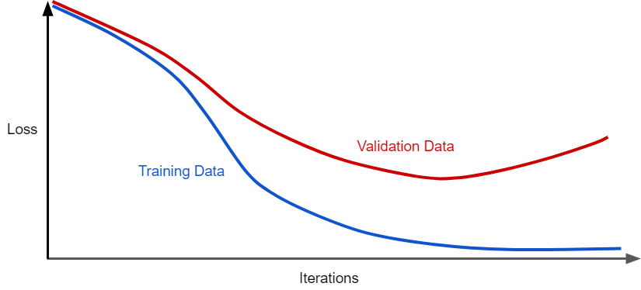
What is Regularization in machine Learning
Have you ever encountered a situation where your machine learning model models the training data exceptionally well but fails to perform well on the testing data i.e. was not able to predict test data? This situation can be dealt with regularization in Machine learning.
Figure 1 shows a model in which training loss gradually decreases, but validation loss eventually goes up. In other words, this generalization curve shows that the model is overfitting to the data in the training set. we could prevent overfitting by penalizing complex models, a principle called regularization.

Slide 4
Overfitting
Overfitting happens when a model learns the very specific pattern and noise from the training data to such an extent that it negatively impacts our model’s ability to generalize from our training data to new (“unseen”) data. By noise, we mean the irrelevant information or randomness in a dataset.
Preventing overfitting is very necessary to improve the performance of our machine learning model.
The model fits the parameters too closely with regard to the particular observations in the training dataset but don’t generalize well to unseen data.
Overfitting means high variance in the model.
One of the ways to reduce overfitting is regularization. Apart from that other methods can also be used such as:
  Collect more training data.
  Choose simple model with few parameters.
  Reduce dimensionality of the data.

Slide 5
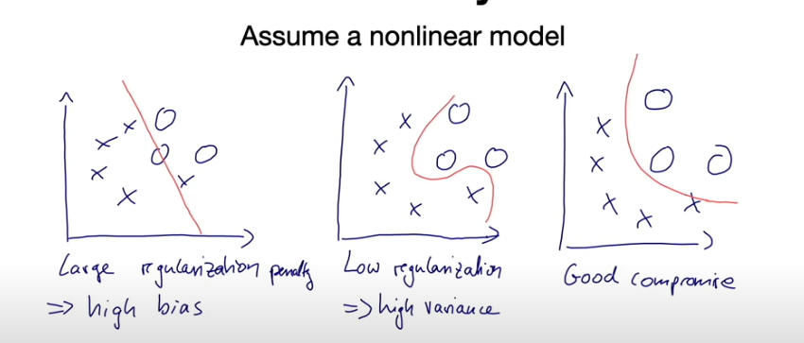
Good fit

Slide 6
To prevent overfitting use regularization
What is Regularization?
In general, regularization means to make things regular or acceptable. This is exactly why we use it for applied machine learning. In the context of machine learning, regularization is the process which regularizes or shrinks the coefficients towards zero. In simple words, regularization discourages learning a more complex or flexible model, to prevent overfitting.

Slide 7
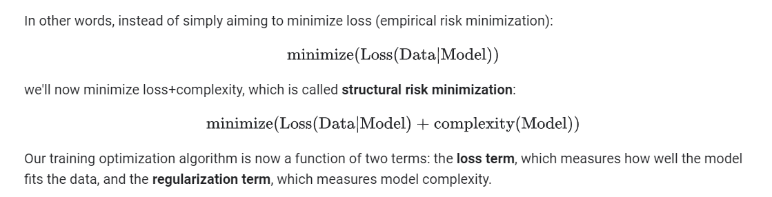
Unregularized loss function
Regularized loss function

Slide 8
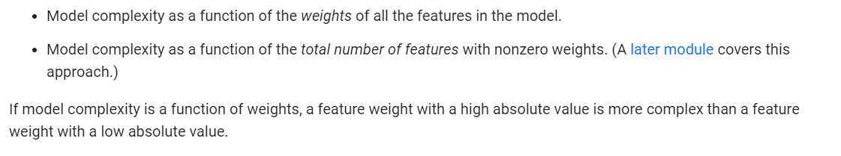

Slide 9
Regularization
Ridge Regression (L2 Regularization)
Lasso Regression (L1 Regularization)
Least Absolute Shrinkage and Selection Operator

Slide 10
L1/L2 Regularization
L1-regularization => LASSO regression
L2-regularization => Ridge regression (Thikonov regularization)
Basically, a "weight shrinkage" or a "penalty against complexity"

Slide 11
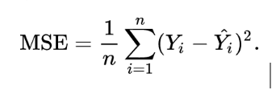
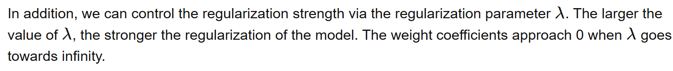
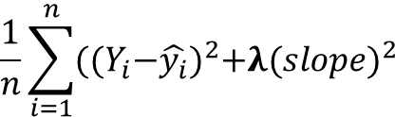

Ridge Regression (L2 Regularization)
In addition, we can control the regularization strength via the regularization parameter λ�. The larger the value of λ�, the stronger the regularization of the model. The weight coefficients approach 0 when λ� goes towards infinity.
Ridge regression modifies the mean squared error in regression by adding the penalty (shrinkage quantity) equivalent to the square of the magnitude of coefficients.
Normal Loss function
tuning parameter/regularization parameter
$$\frac{1}{n}\sum_{i=1}^{n}{{({(Y}_{i}−\hat{y_{i}})}^{2}+λ({slope)}^{2}}$$
Normal Loss function+ Regularization term=
Normal Loss function + $L_{2}$Regularization term

Slide 12
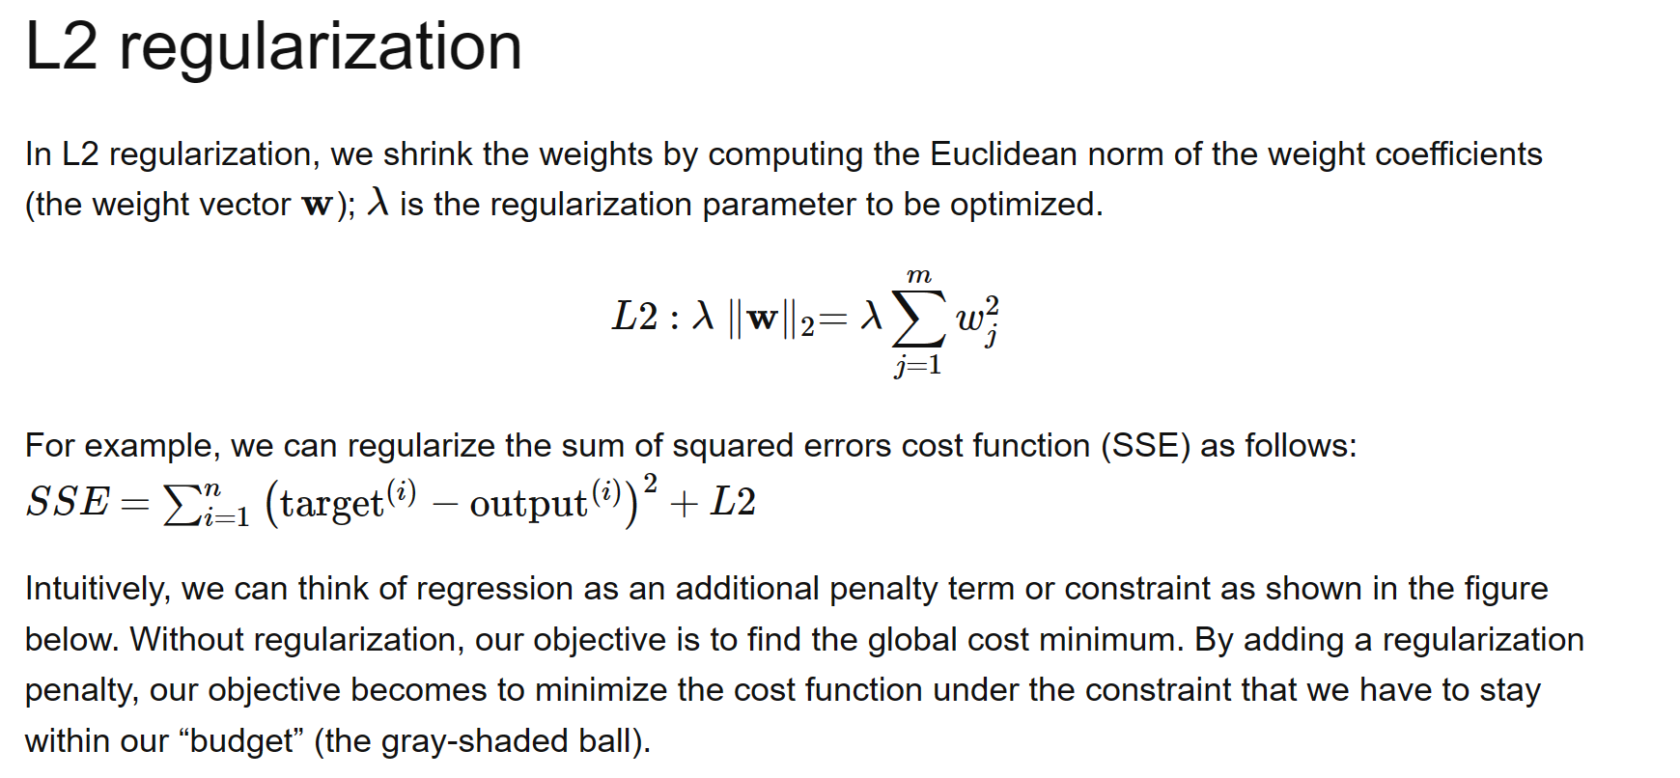
L2 norm of weight vector

Slide 13
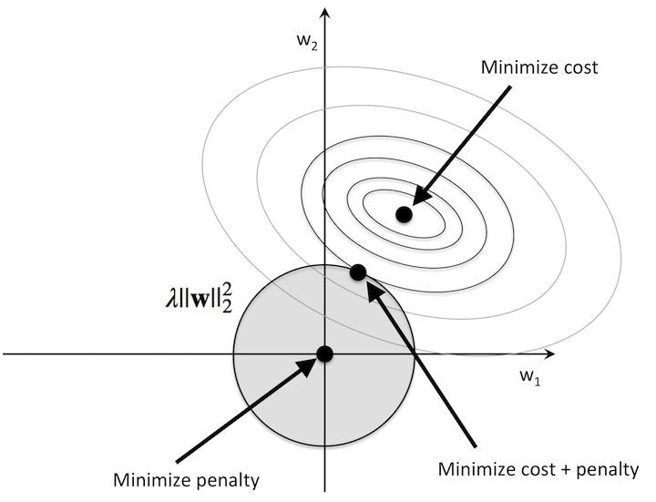
Geometric interpretation of L2 Regularization
Grey ball shape: represents L2 regularization term
Weight coefficients cannot fall outside shaded area, at the same time we want to reduce the error
Under the penalty constraint, our best effort is to use the point where L2 ball intersects with the contours of the unpenalized loss function.

Slide 14
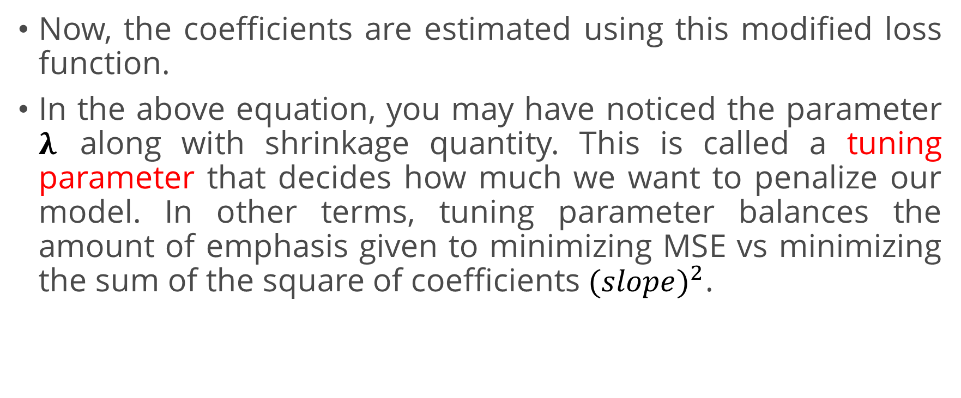
Now, the coefficients are estimated using this modified loss function.
In the above equation, you may have noticed the parameter $λ$ along with shrinkage quantity. This is called a tuning parameter that decides how much we want to penalize our model. In other terms, tuning parameter balances the amount of emphasis given to minimizing MSE vs minimizing the sum of the square of coefficients $({slope)}^{2}$.

Slide 15
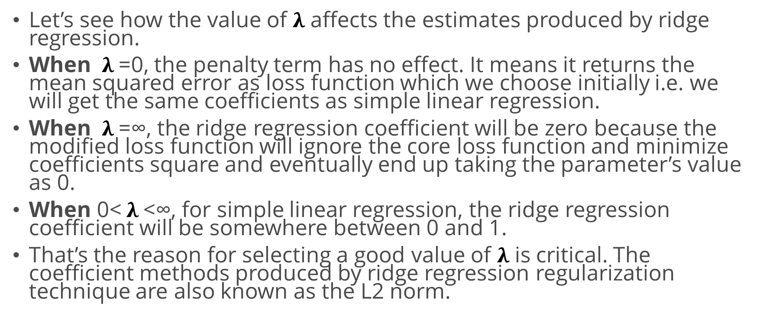
Let’s see how the value of $λ$ affects the estimates produced by ridge regression.
When $λ$=0, the penalty term has no effect. It means it returns the mean squared error as loss function which we choose initially i.e. we will get the same coefficients as simple linear regression.
When $λ$=∞, the ridge regression coefficient will be zero because the modified loss function will ignore the core loss function and minimize coefficients square and eventually end up taking the parameter’s value as 0.
When 0< $λ$<∞, for simple linear regression, the ridge regression coefficient will be somewhere between 0 and 1.
That’s the reason for selecting a good value of $λ$ is critical. The coefficient methods produced by ridge regression regularization technique are also known as the L2 norm.

Slide 16
Features of Ridge regression
Reduces overfitting
Ridge Regression is a popular type of regularized linear regression that includes an L2 penalty. This has the effect of shrinking the coefficients for those input variables that do not contribute much to the prediction task.
Ridge Regression is an extension of linear regression that adds a regularization penalty to the loss function during training.
Have the capability to drive the coefficients towards zero but not equal to zero.

Slide 17
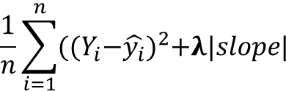

Lasso Regression (L1 Regularization)
This regularization technique performs L1 regularization. It modifies the mean squared error by adding the penalty (shrinkage quantity) equivalent to the sum of the absolute value of coefficients. Lasso regression can drive coefficients to be zero, hence it can act as feature selection method
Normal Loss function
$$\frac{1}{n}\sum_{i=1}^{n}{{({(Y}_{i}−\hat{y_{i}})}^{2}+λ|{slope|}^{}}$$
Normal Loss function+ Regularization=
Normal Loss function + $L_{1}$Regularization term

Slide 18
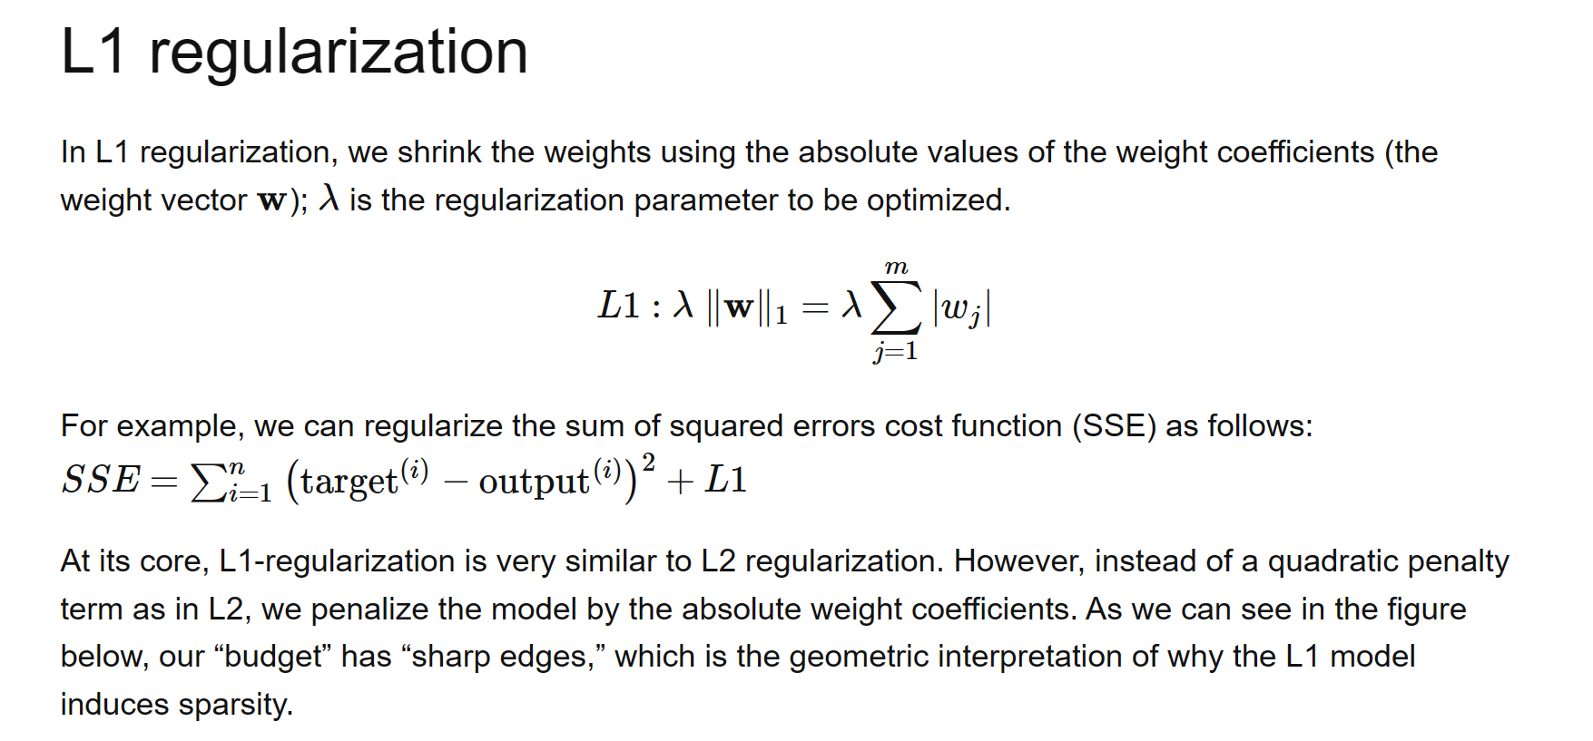
Sum of the absolute weight coefficients

Slide 19
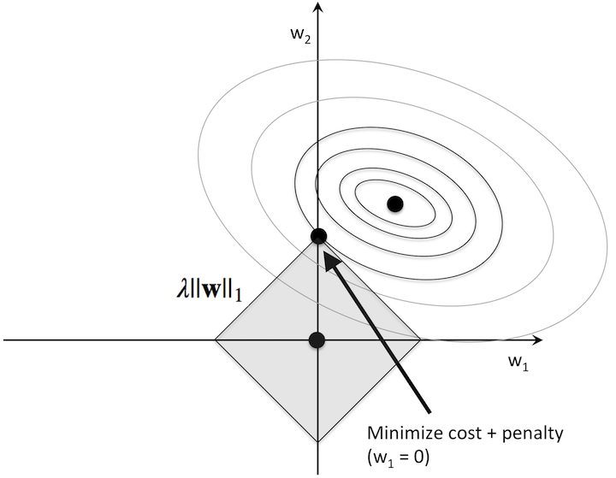
Geometric interpretation of L1 Regularization
In Figure we can see that contours of the loss function touches the L1 Dimond at w1=0.
Since the contours of an L1 regularized system are sharp , it is more likely that the optimum –that is, the intersection between eclipses of the loss function and boundary of L1 diamond is located on the axes that encourages sparsity.

Slide 20
Lasso Regression is different from ridge regression as it uses absolute coefficient values for normalization.
As loss function only considers absolute coefficients (weights), the optimization algorithm will penalize high coefficients. This is known as the L1 norm.
Lasso regression not only tries to prevent overfitting but also acts as a feature selection method because it can drive the coefficients to exactly zero, if they are not important in the model (Sparse feature vector)

Slide 21
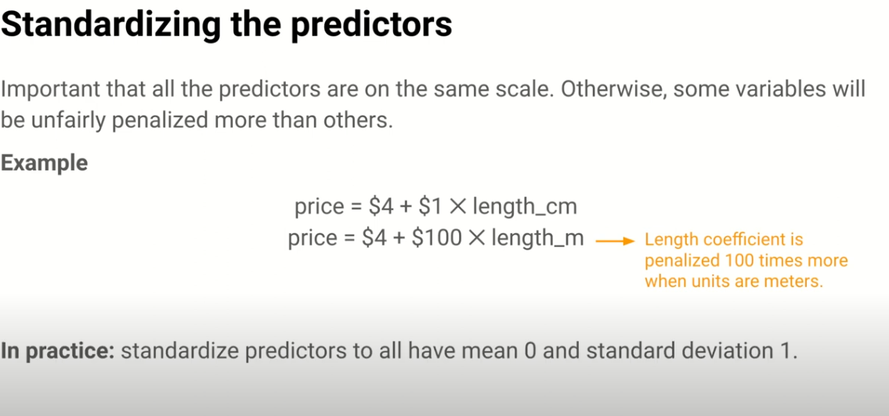

Slide 22
